Slide 1
CSE 575 Class Project Presentation Weather Forecasting
Team Members:
Balaji Sankar – 1209346459 - bsankar@asu.edu – 20% contribution
Karthik Subramanian – 1209360876 - ksubra19@asu.edu – 20% contribution
Aarti Rao Manjeshwar – 1209163211 - amanjesh@asu.edu – 20% contribution
Shwetha Narayanan – 1209166097 - snaray36@asu.edu – 20% contribution
Ramanathan Nachiappan – 1210822532 – rnachiap@asu.edu - 20% contribution

Slide 2
Overview
Introduction
Data Sets
Time Series Data modelling
Proposed approaches
PCA and Feature Selection
Baseline - Naïve Persistence model
ARIMA Modeling
Time Series Linear Modeling
Nearest Neighbor Modeling
Results

Slide 3
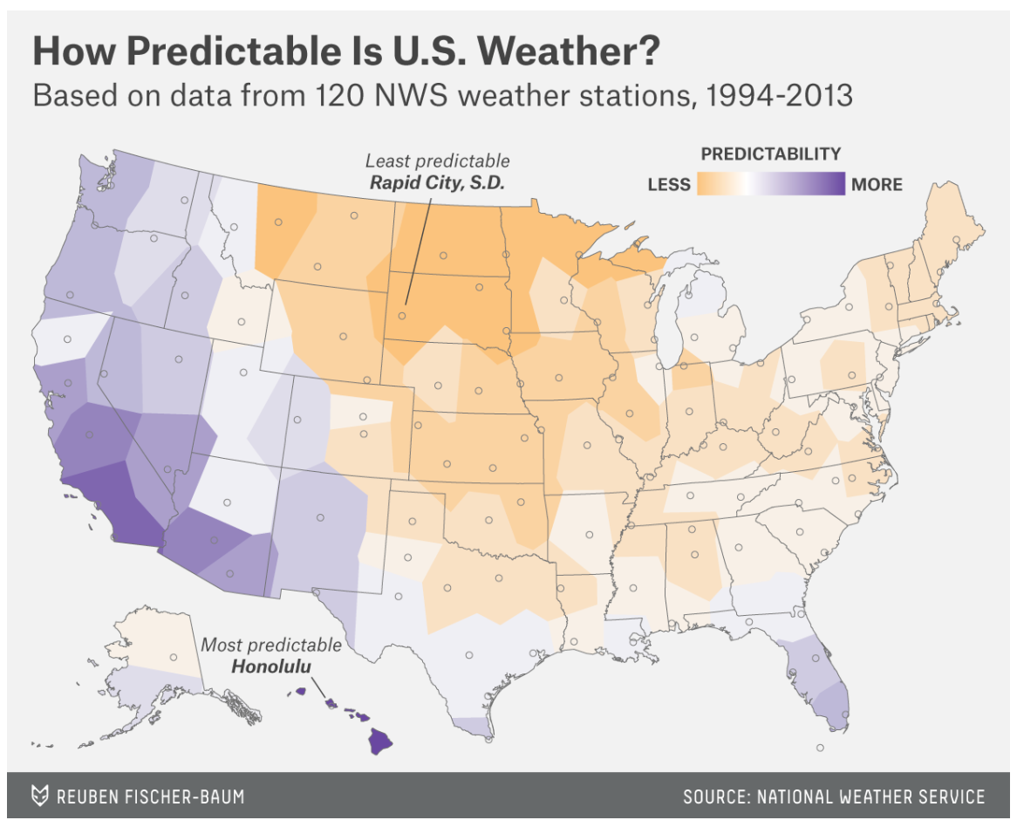

Slide 4
Data Sets
Source: http://www.noaa.gov/
National Oceanic and Atmospheric Administration by the U.S Department of Commerce
Data Set Sample:
Seattle, Dallas and Cincinnati Weather data
Parameters – Sunrise, sunset, wind speed, precipitation, dew point, wet bulb temperature, pressure change, sky conditions etc. (92 features)

Slide 5
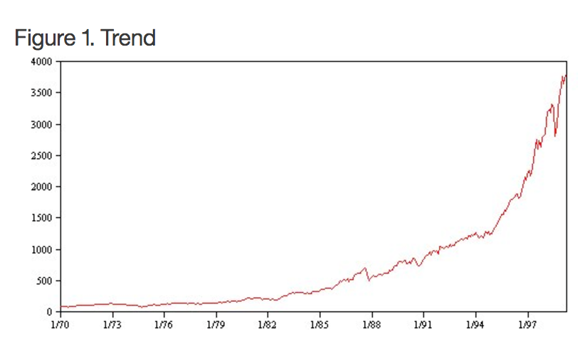
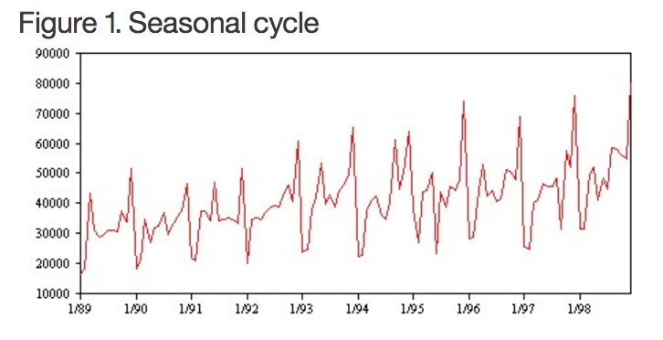
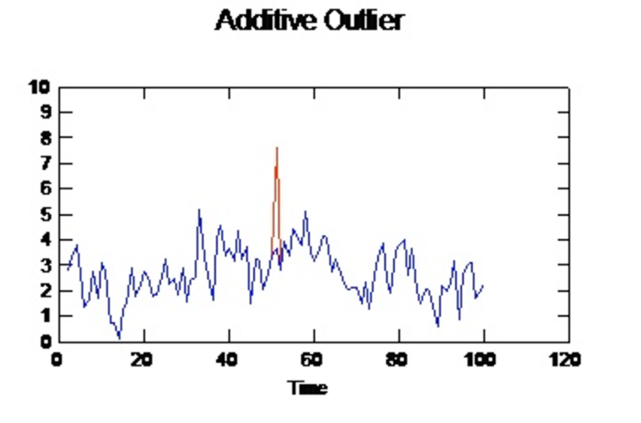
Time Series Characteristics

Slide 6
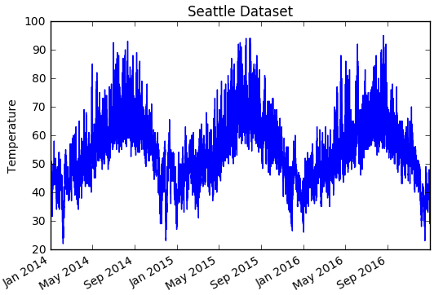
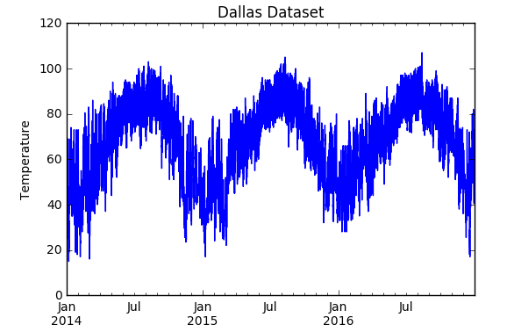
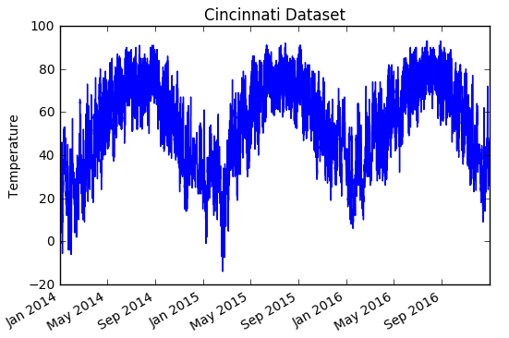
Weather is seasonal!

Slide 7
Proposed Approaches
Data Set Feature Extraction using PCA
Feature Selection – Stepwise Regression
Base model using Naïve Persistence
ARIMA Modeling
Time Series Linear Modeling
K Nearest Neighbor Modeling

Slide 8
Preprocessing
Original features | 92
Reduced manually | 19
Aggregated data | collapsed into hourly

Slide 9
Feature Extraction using PCA
Find variance of each column
Sort by variance of each column
Find the number of columns which have positive variance
This represents the ideal set of features
Positive variance indicates that the feature is not closely related to other features
Apply dimensionality reduction using PCA for these number of features

Slide 10
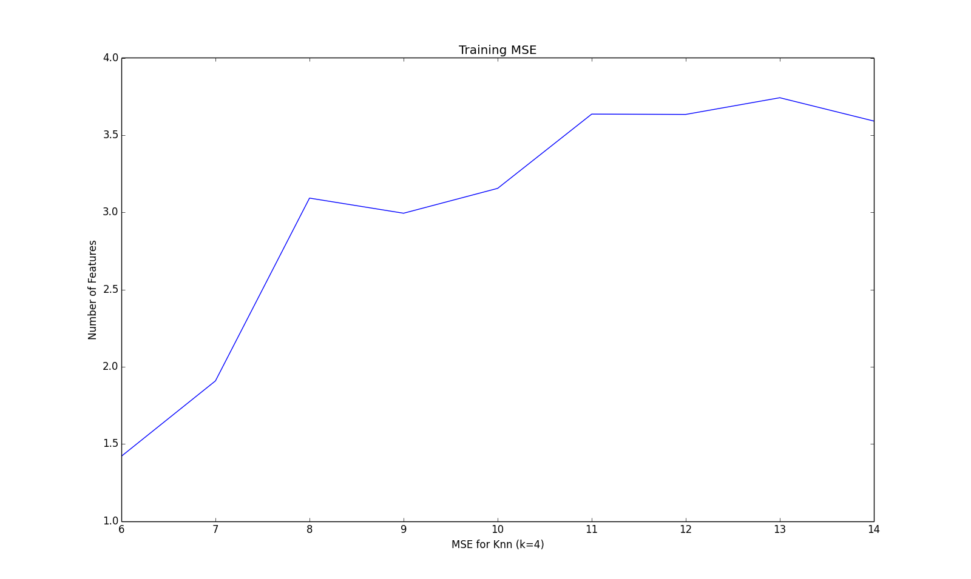
Choosing Number of Dimensions for PCA

Slide 11
Step-wise regression for feature selection
Selected Features
Cincinnati | Precipitation, Pressure and Visibility
Dallas | Humidity, Wind Direction and visibility
Seattle | Wet bulb temperature, precipitation, pressure change

Slide 12
Baseline Prediction for Time Series
We used the persistence algorithm in establishing the baseline performance
Persistence Algorithm:
Also called “Naïve” Forecast which is equivalent to the ‘Zero Rule’ algorithm
This algorithm uses the value at the previous time step t-1 (input) to predict the outcome in the next time step t+1 (output)
Dataset split – Training -2/3rd and Testing – 1/3rd
This assumes nothing about the specifics about the time series to which it is applied, thus making it naïve and establishing a baseline performance

Slide 13
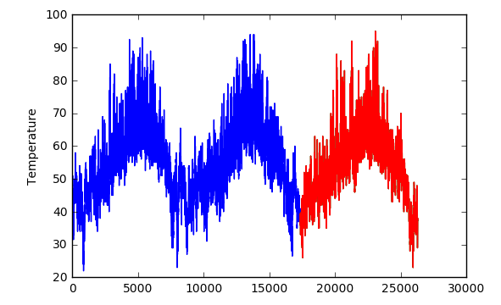
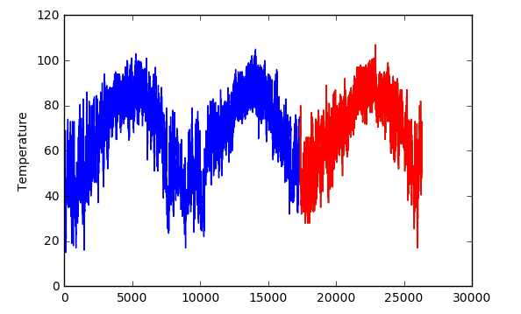
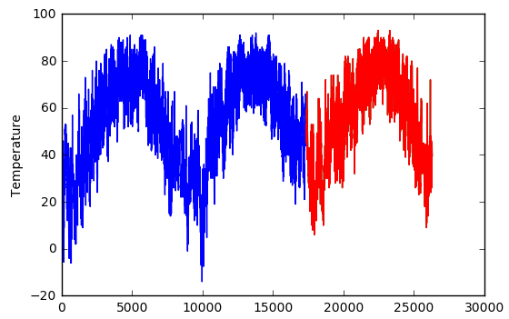
Predictions
Seattle
Dallas
Cincinnati

Slide 14
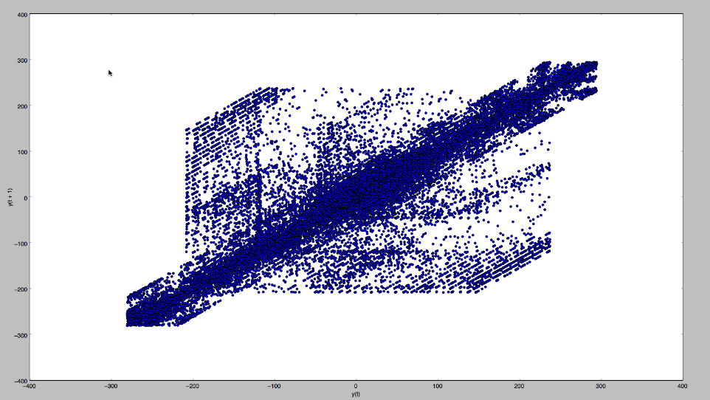
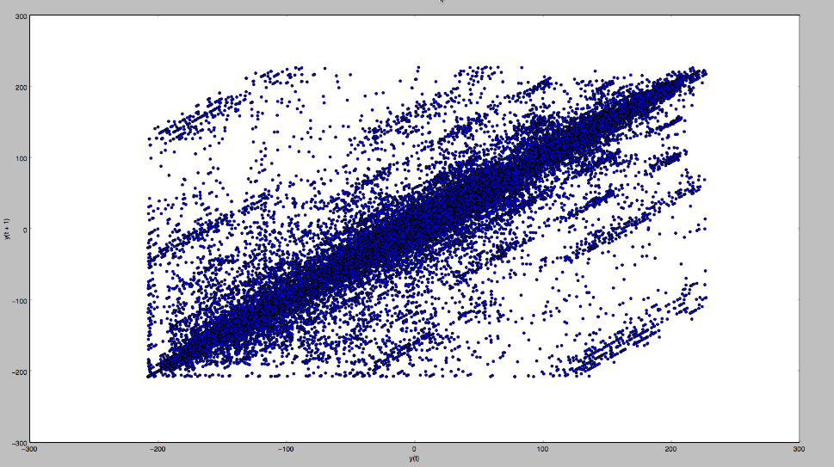
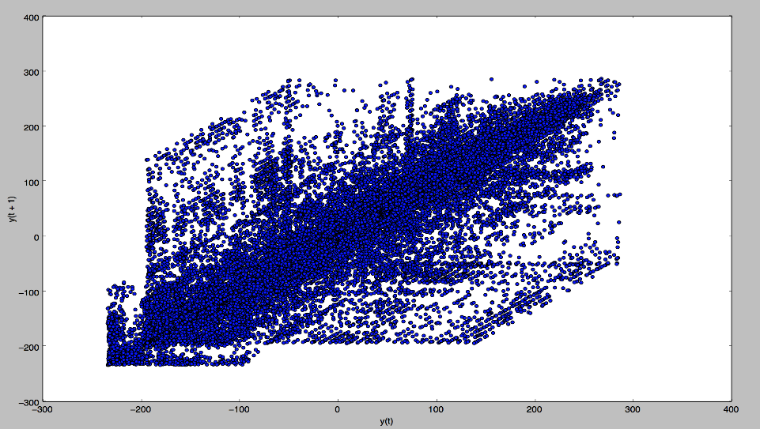
Correlation Check between t-1 and t+1
Seattle
Dallas
Cincinnati

Slide 15
AR Modeling
AR model is similar to the baseline prediction model in terms of predicting outcome using the observation of the previous time step
However the approach is not naïve, but based upon linear regression model (a linear combination of input values)
For example X(t+1) = w0 + w1*X(t-1)
This relationship between variables is called correlation and we performed a correlation check for the two variables t+1 and t-1

Slide 16
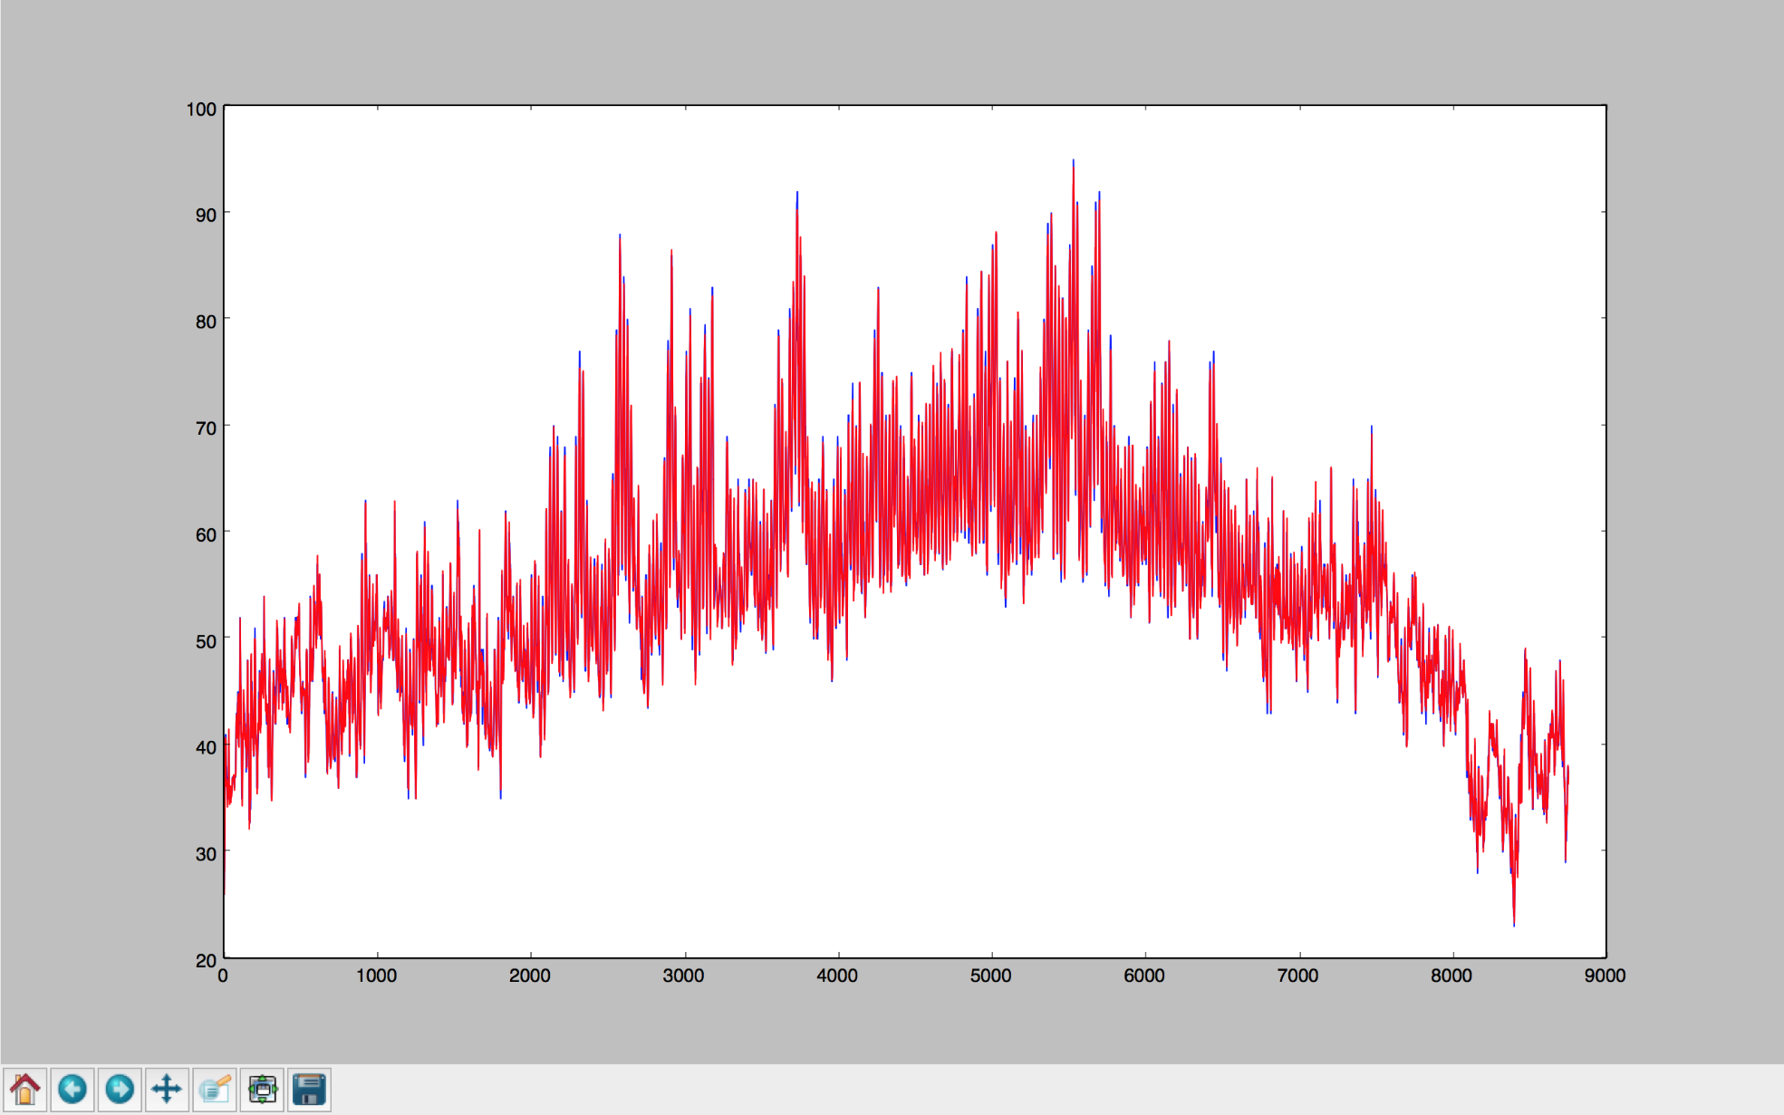
AR Results Seattle

Slide 17
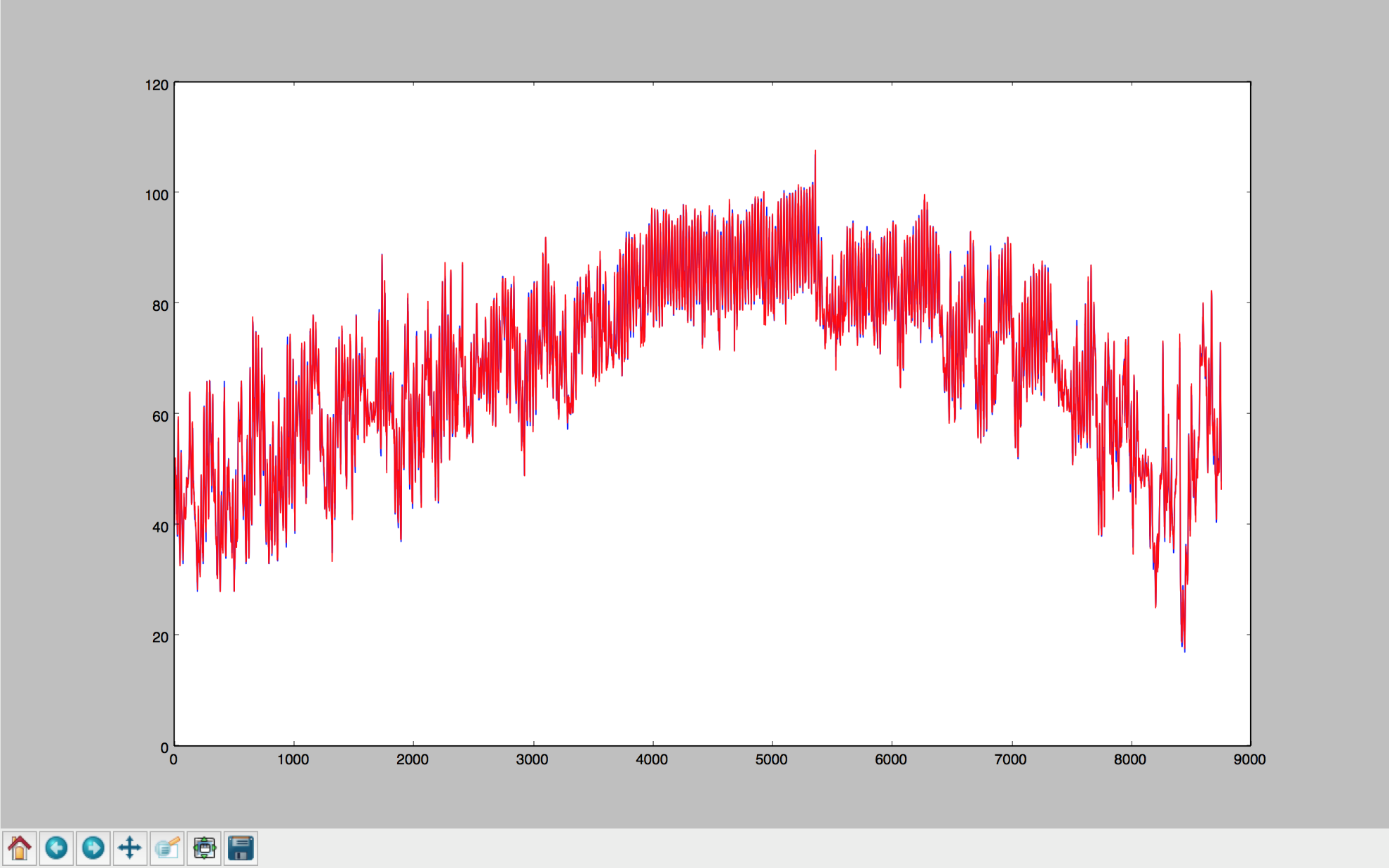
AR Results Dallas

Slide 18
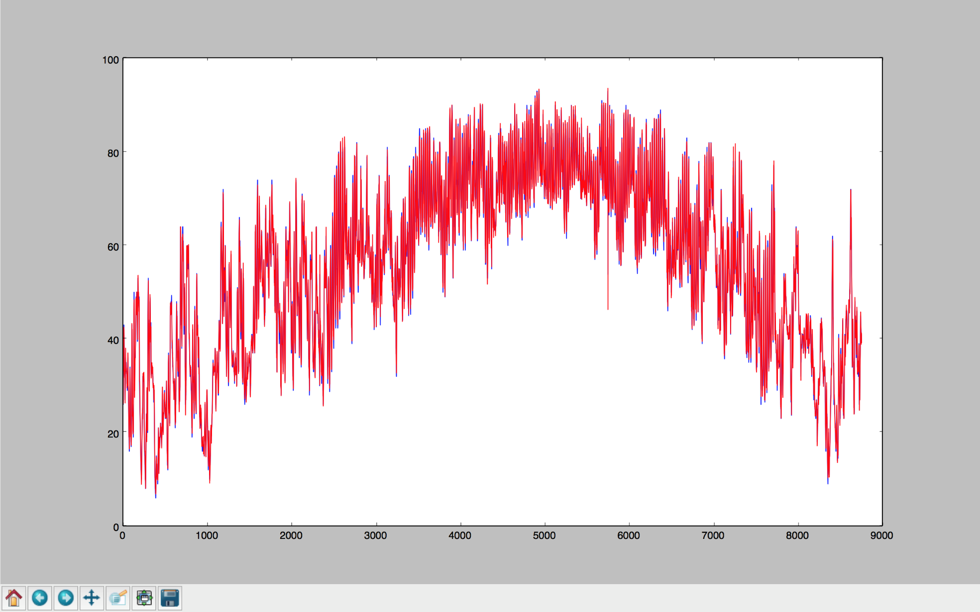
AR Results Cincinnati

Slide 19
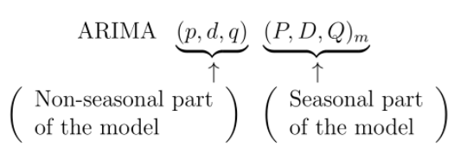
ARIMA
Combination of autoregressive (AR), integration (I) - and moving average (MA) operations.

Slide 20
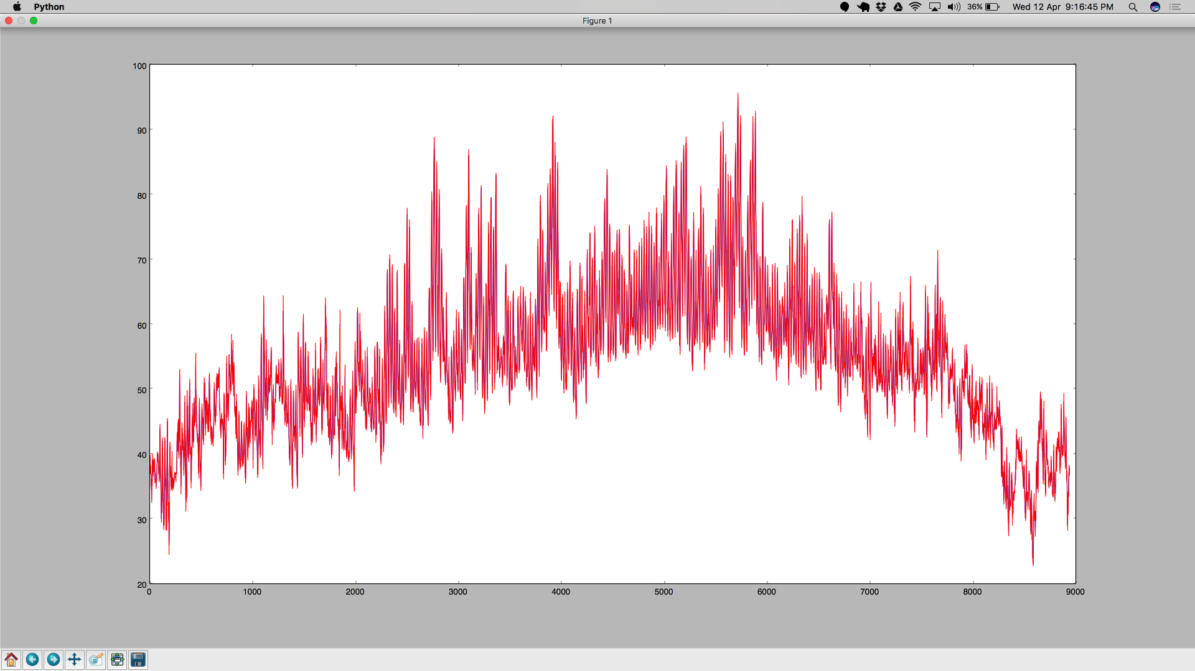
ARIMA Results Seattle

Slide 21
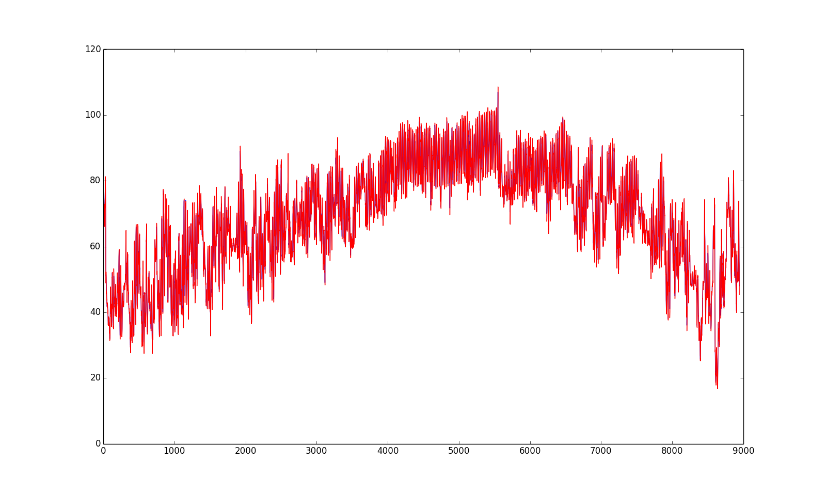
ARIMA Results Dallas

Slide 22

ARIMA Results Cincinnati

Slide 23
Nearest Neighbor Modeling
Created a lagged dataset (by 1 day)
Mapped attributes to next day’s temperature
Split data into train and test (random sampling)
Trained model with selected features

Slide 24
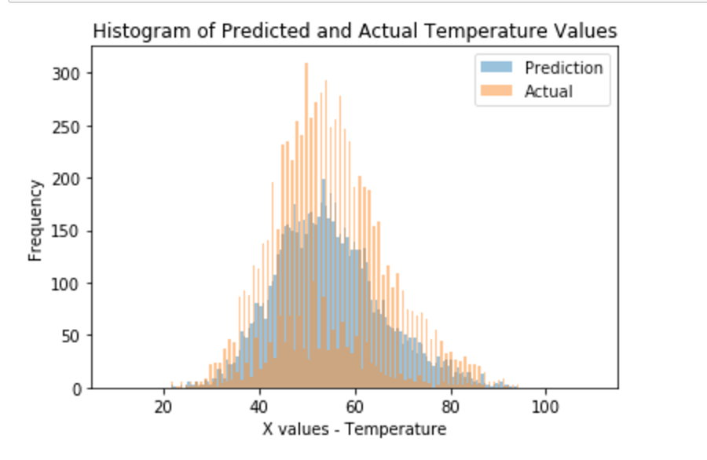
KNN Prediction Seattle

Slide 25
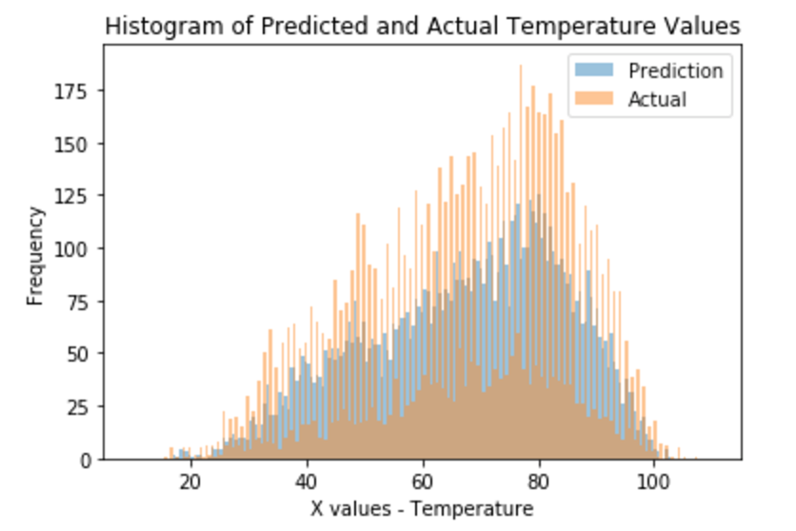
KNN Prediction Dallas

Slide 26
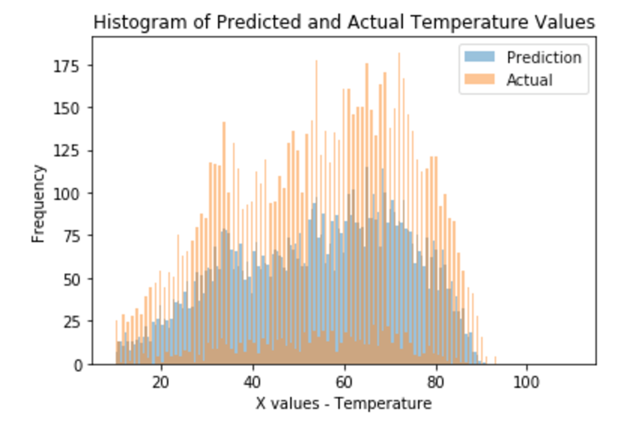
KNN Prediction Cincinnati

Slide 27
Time Series Linear Modeling
Linear model that retains the Time Series Characteristics
Includes seasonal and trend components
Includes external variables from Stepwise Regression

Slide 28
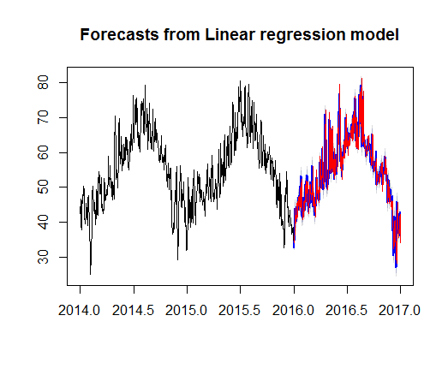
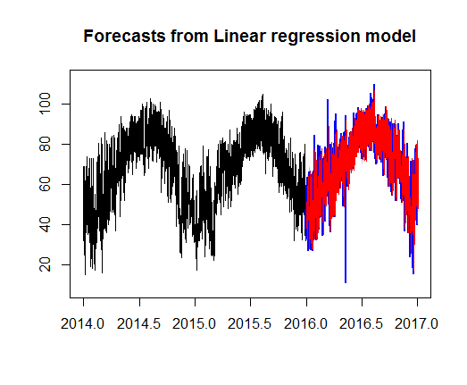
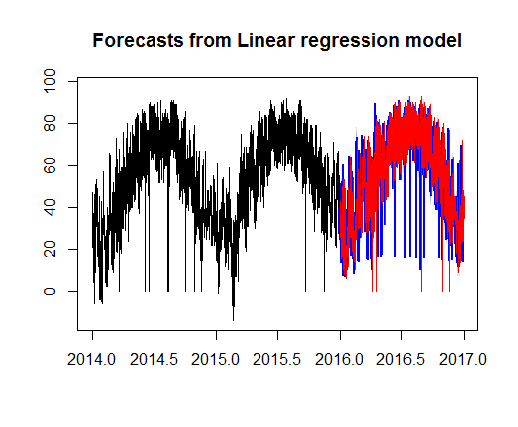
TSLM Predictions
Seattle
Dallas
Cincinnati

Slide 29
Results
Model | Seattle MSE | Dallas MSE | Cincinnati MSE
Baseline | 3.17 | 4.6 | 6.67
AR | 1.879 | 2.394 | 4.247
ARIMA | 2.437 | 3.337 | 5.247
TSLM | 3.4 | 13.2 | 14.8
KNN (k=4) | 3.617 | 6.75 | 8.019

Slide 30
Team Members
Balaji Sankar – 1209346459 - bsankar@asu.edu – 20% contribution
PCA
KNN
Karthik Subramanian – 1209360876 - ksubra19@asu.edu – 20% contribution
Data Preprocessing
KNN
Aarti Rao Manjeshwar – 1209163211 - amanjesh@asu.edu – 20% contribution
Baseline Persistence Model
Autocorrelation
Shwetha Narayanan – 1209166097 - snaray36@asu.edu – 20% contribution
Stepwise Regression
TSLM
Ramanathan Nachiappan – 1210822532 – rnachiap@asu.edu - 20% contribution
AR
ARIMA
“All the team members agree on the team members’ contributions in terms of both (a) what s/he did and (b) the percentage”

Slide 31
Thank You!
“All the team members agree on the team members’ contributions in terms of both (a) what s/he did and (b) the percentage”

